Slide 1

THE ROAD TO THE INTERNET
Birth of the American Meteorological Society AERA program
(Atmospheric Education Resource Agent)
Introducing a Web based Instructional Model for Middle and High School teachers of Earth Sciences

Slide 2
Rational
To improve science education at the pre- college level by focusing on a discipline that is of interest to all students:
WEATHER…..
Or …. maybe
ASTRONOMY?

Slide 3
THE BIRTH OF AN IDEA
First order of formation was the establishment of AERA teams representing every state
Summer workshops were designed and initiated to indoctrinate the AERA in the expectations of the AMS education outreach program. Each workshop afforded the teachers a chance to interact, share ideas, and establish lines of supportive communication.

Slide 4
SUMMER OBJECTIVES
Each summer session included a series of presentations of “learning material” for AERAS.
Specific focus was on topics that would support teachers presenting new learning modules in workshops for the coming year.

Slide 5
DEVELOPING INSTRUCTIONAL MATERIALS
The highest order of business for the AERA’s and AMS personal was to develop a minimum of two new learning modules per year. These modules were independently “packaged” so that a single concept could be presented at a workshop or conference meeting.

Slide 6
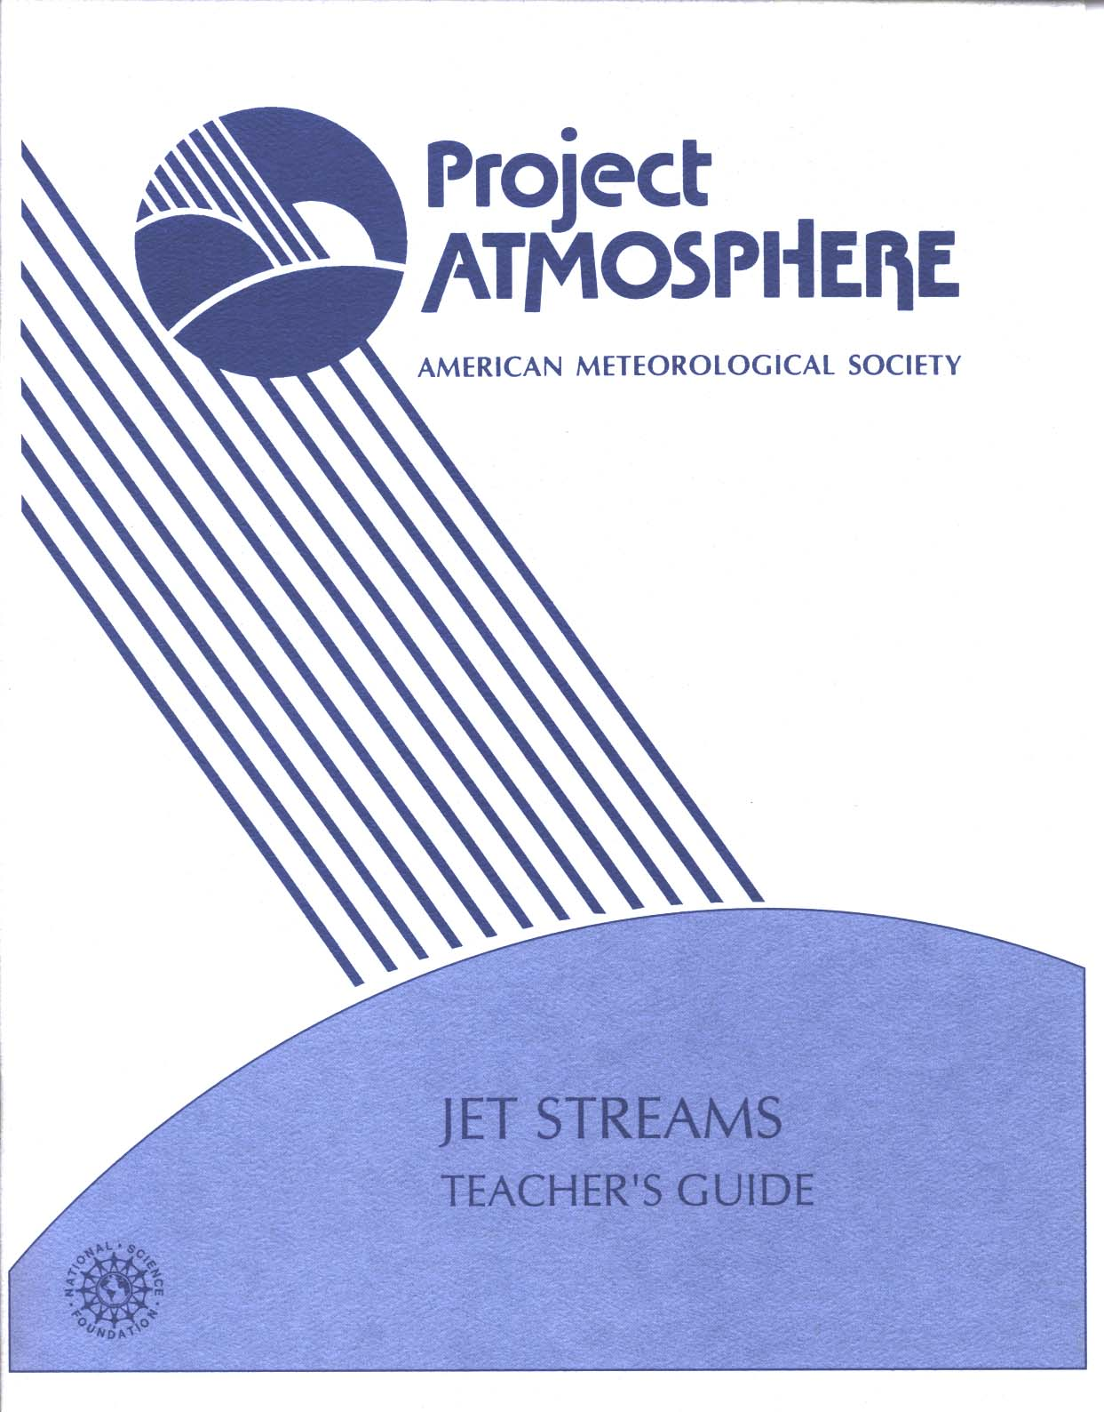
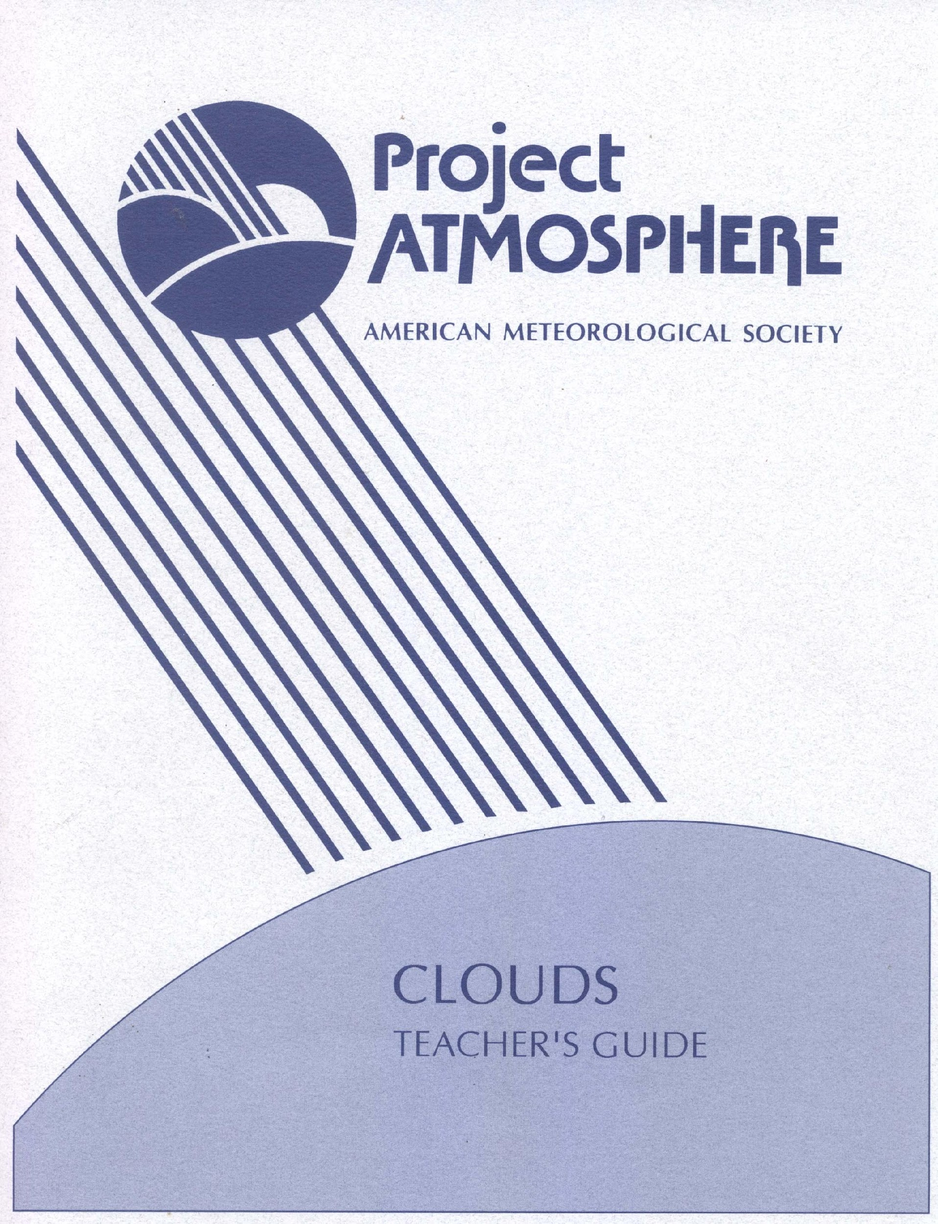
Sample Single Concept Modules

Slide 7
AMS AERA Action
For a period of about five years, the AERA network conducted numerous workshops at state and national conferences and many focused on smaller outreach efforts to rural districts.
Learning materials were discussed and distributed for evaluation at these workshops.

Slide 8
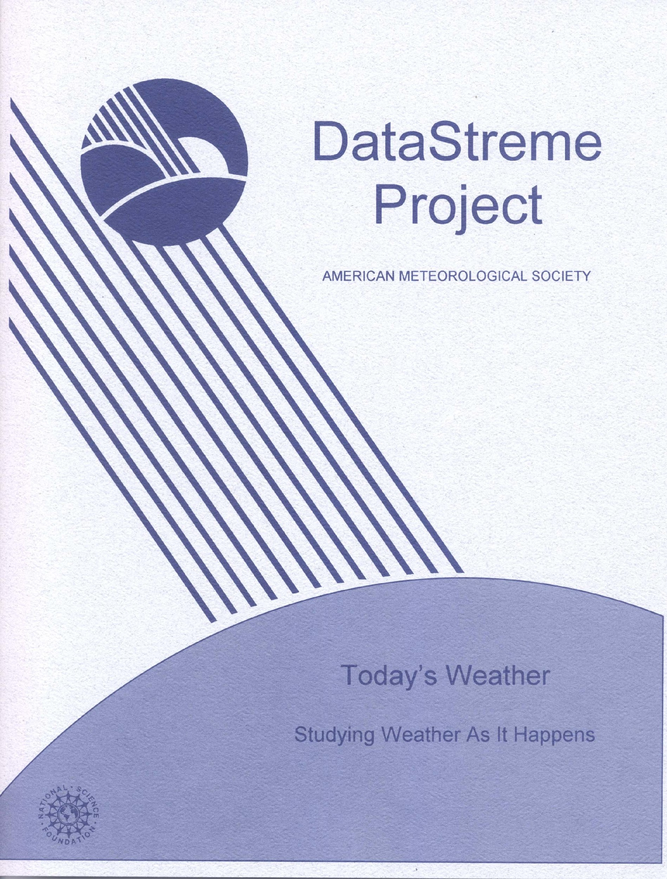
A CONDENSED GUIDE
Over time, a more detailed multiple guide was designed for workshops having 4 individual activities

Slide 9
Real Time Science
The AMS AERA initiative grew from numerous programs designed to bring real time weather to the classroom
The prepared instructional guides were designed to incorporate real time events and data.
Prior to the popularity of the Internet and its ease of operation, efforts were initiated to provide teachers with real data.

Slide 10
Providing Classroom Data
Initial efforts involved Vertical Blanking.
Evaluations indicated this format was too complicated for the designated target teacher.
Using the Internet as a distributor of learning materials was investigated and found satisfactory.
A need existed for developing a sound strategy for delivering the information.

Slide 11
Teaching with the Internet
Feedback from the state AERA’s indicated that the focus should be on enabling teachers to present quality science lessons.
The leadership within the Professional society (AMS) recognized:
That they can present science concepts
That teachers can best determine how to append this material to their lessons.

Slide 12
DEVELOPING AN EFFECTIVE INSTRUCTIONAL MODEL
Teams of AERA’s and Society members convened to determine the most appropriate model for delivering a teacher education program that would also enhance student learning.
Delivery had to be
“teacher friendly”
Interactive
Employ real time data.

Slide 13
THE WEB MODEL
The program would provide multiple presentations.
Instructive and supportive Text material
Delivery of real time data and activities using the internet
Availability of data for other activities and for student use via the Internet.

Slide 14
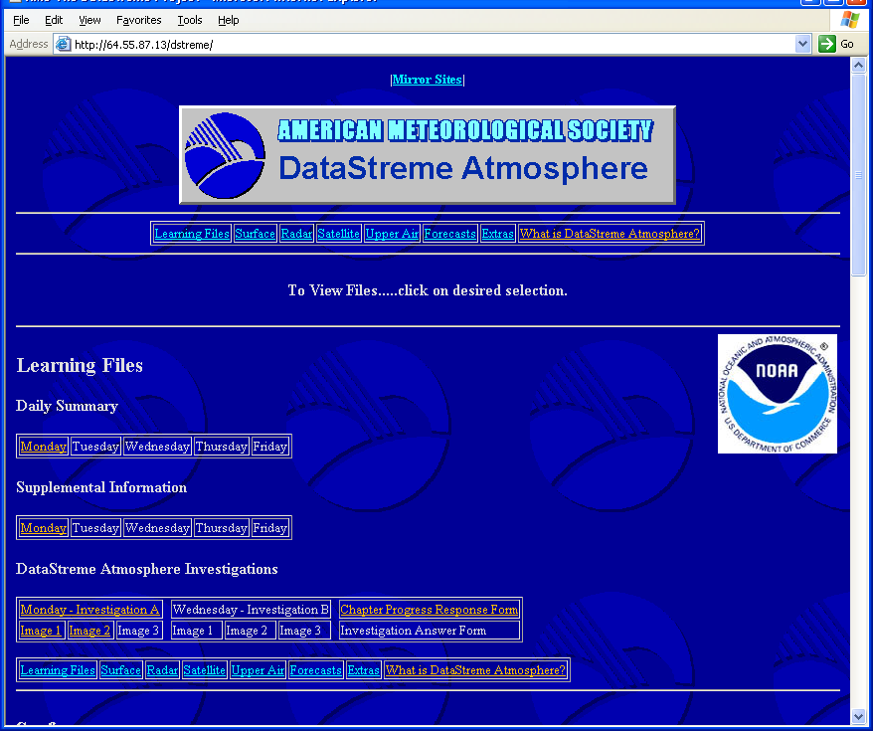

Slide 15
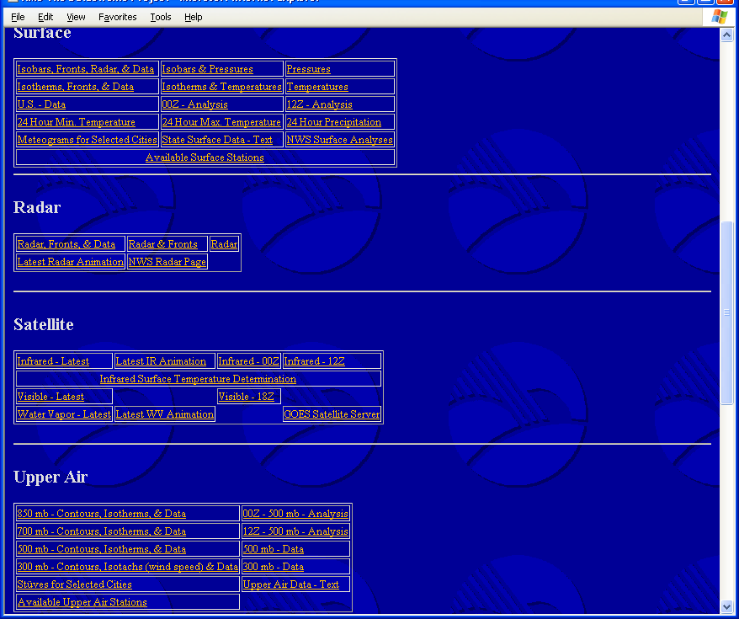

Slide 16
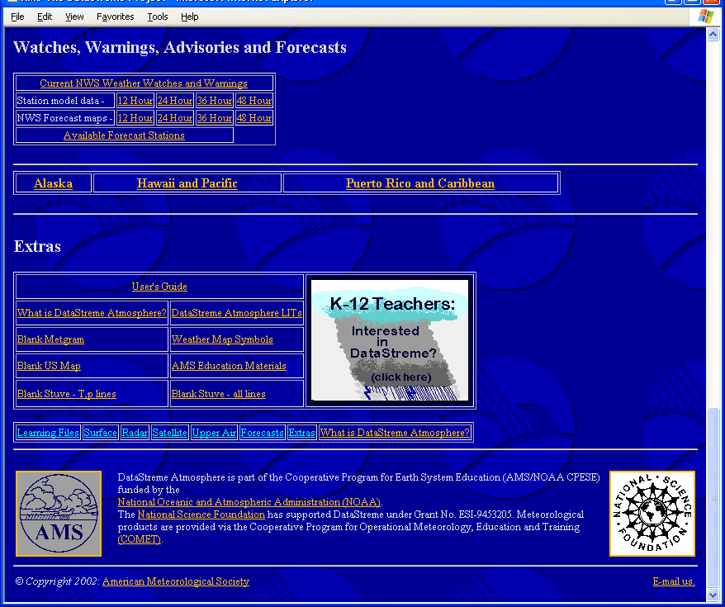

Slide 17

THE TEXTBOOK
A text book was designed to provide the background information required to understand the basic principals governing the topic of weather.

Slide 18

ACTIVITIES GUIDE
24 Interactive inquiry activities were designed to compliment the text.
Each chapter in the narrative involves the teacher in two major learning activities.

Slide 19
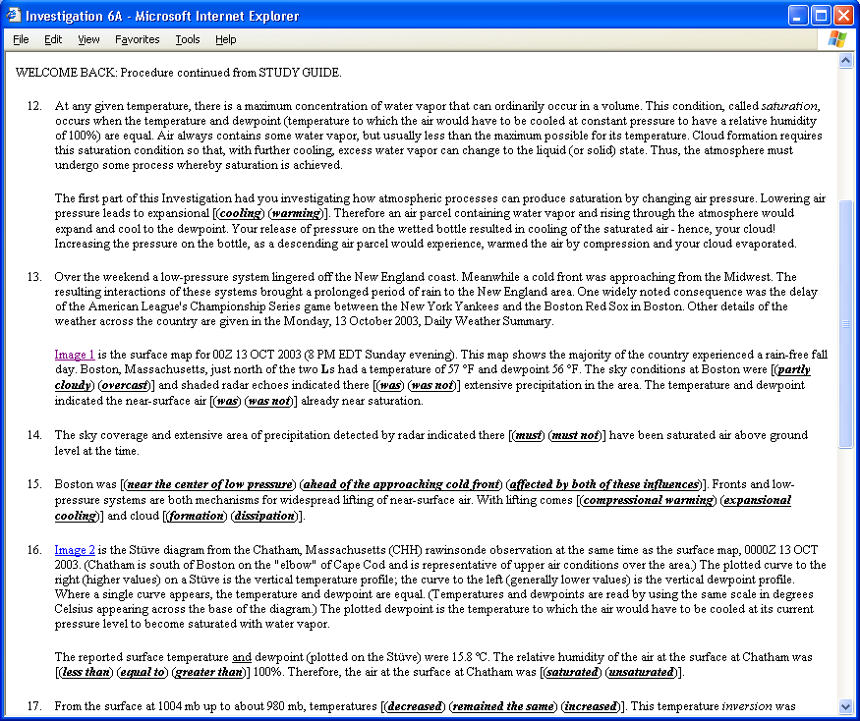

Slide 20
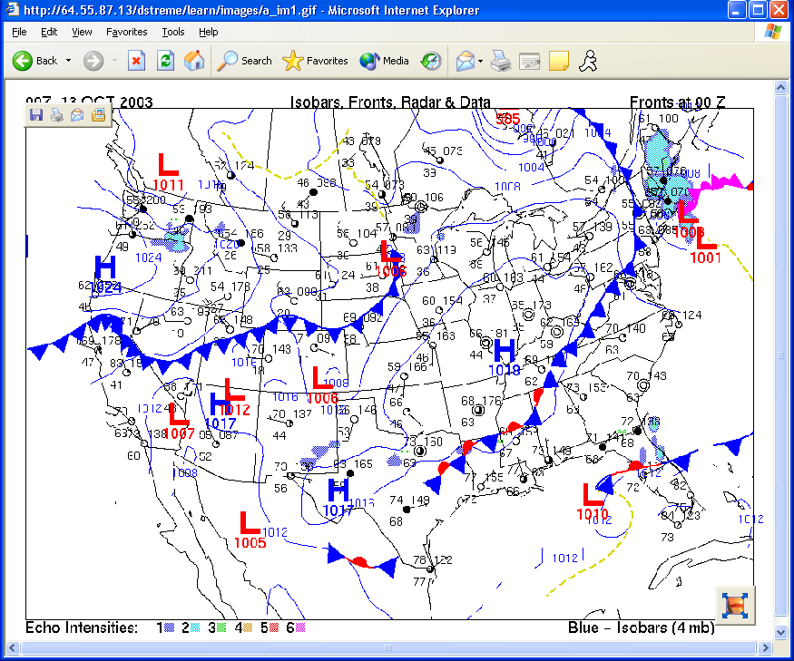

Slide 21
INSTRUCTIONAL MODEL
Local Implementation Teams (LIT’s) coordinate delivery of the course.
Each team consists of an AERA and two professional members of the Meteorology community. (Professors, NWS, Private)
The trained AERA is the team leader
LIT members work collegially with each other and course participants

Slide 22
LIT’s RESPONSIBILITIES
Recruitment and selection of course participants
Act as mentors to specific participants
Provide timely review, evaluation, and support for completed assignments
Coordinate with other LIT members
Assess and evaluate overall progress of participants and recommend final grade

Slide 23
THE ROLE OF THE INTERNET
Deliver the weekly “real time” learning activities.
Provide interesting information about daily events that pertain to the course
Provide data sets that can be used by current and former participants
Provide easy access to images and data in a user friendly manner
Provide information for future participation.

Slide 24
ROLE OF THE PARTICIPANT
Attend scheduled course meetings (3)
View the web site several times per week
Successfully complete two learning activities each week. (electronically deliver completed activities to LIT)
Interact weekly with LIT
Cite in-class use of materials
Develop plans for being a resource teacher.

Slide 25
PARTICIPANT EVALUATION
Program allows teachers to participate in a course of study in a low stress, self paced environment
Program provides access for accredited study (3 graduate credits)
LIT model is friendly, supportive, and provides access to professional assistance
Material is adaptable to classroom use

Slide 26
Effectiveness
Approximately 8,000 teachers have participated in this program for 3 graduate credits
Over 100,000 students have benefited from teacher enhancement
A second program was funded by NSF to study Water in the Earth System
A third program is currently being field tested concerning physical oceanography.

Slide 27
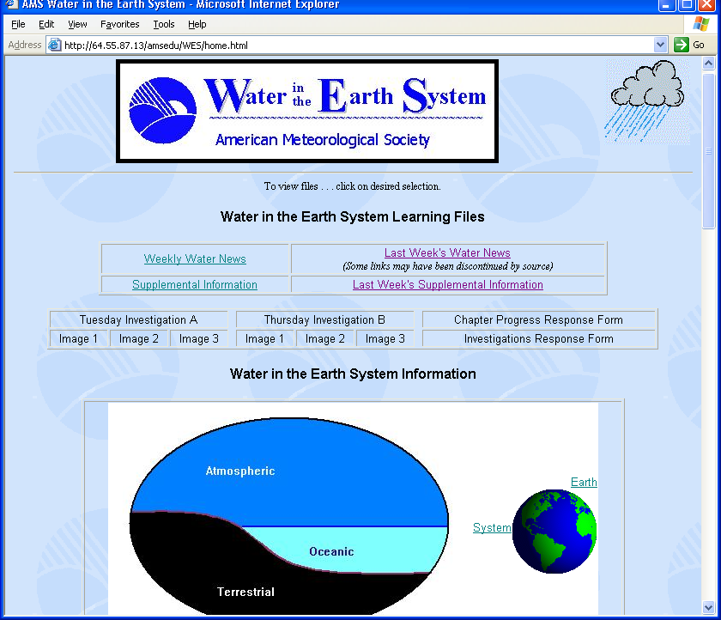

Slide 28
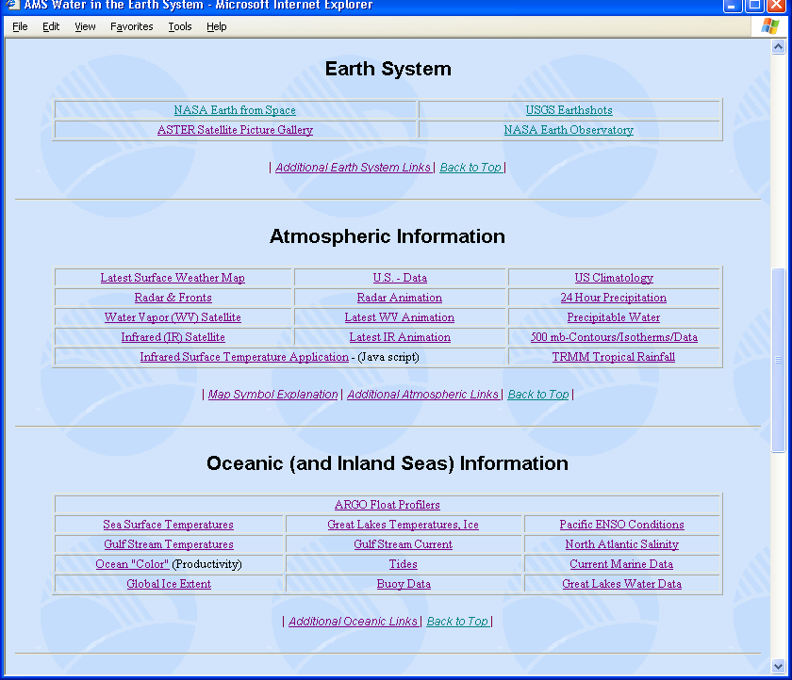

Slide 29
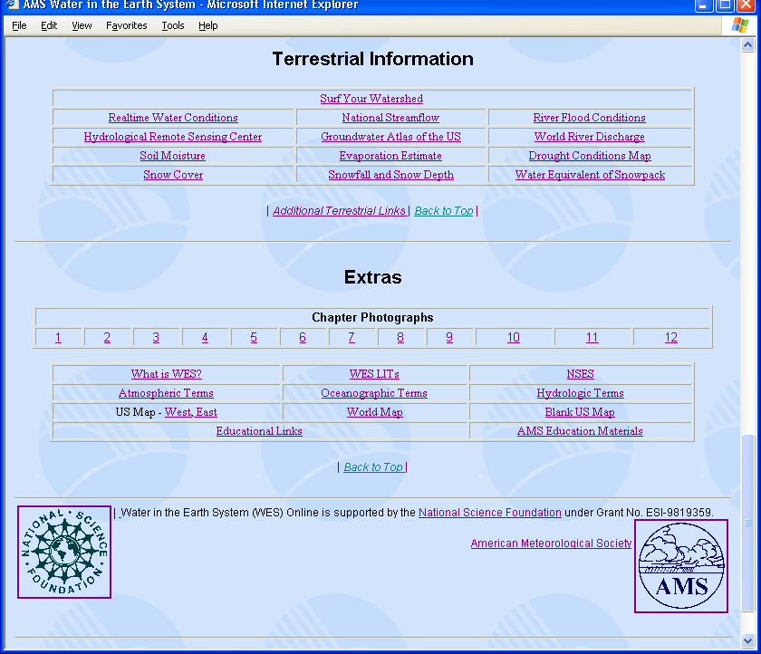

Slide 30
POTENTIAL FOR ASTRONOMY
There already exist study modules designed for GLAST and Swift that parallel the early work of the AMS
There is a need to prepare pre-college teachers to present science concepts inherent in Astronomy that are consistent with the National Standards and emphasize physical sciences and math skills.

Slide 31
SCIENCE EDUCATION NEEDS
New professional development schools for teachers have increased required science education credits at the expense of content
Young Science teachers lack the depth of science preparation required for today’s curriculums
Young practicing teachers in most rural areas and regions distant from a college experience difficulty earning meaningful science credits
Few colleges and universities offer physical science courses during the summer months

Slide 32
WHY THE INTERNET MODEL WORKS
Teachers can complete the course during the academic year
Time spent traveling can be more efficiently applied to independent study
Teachers are encouraged to enroll in programs with a buddy
Teachers appreciate the opportunity to complete their studies on personal timelines (averages 3-4 hours per week)

Slide 33
WHY THE AMS MODEL WORKS
The program was designed to work with the internet
Teachers enjoy the framework of Collegially of the learning process
Narrative material was efficiently designed to fit into the course of study
Inquiry activities were designed to complement the narrative instruction and lend themselves to classroom use

Slide 34
Emphasis is on application of the instructional material
Evaluation focuses on the understanding of the applied concepts
Course evaluation relies heavily on completion of the material and LIT interaction
Extraneous education papers are avoided

Slide 35
SUMMARY
The AMS distant learning projects under the support of the NSF were able to design unique and functional Internet delivered courses of study.
These programs are designed for teachers and administered by teachers responsible to the standards of a professional society
Professional Societies and Government agencies have recognized and supported these programs.

Slide 36
Summary Continued
Teachers earn college credit
Participating Teachers are encouraged and trained to function as resource agents for their state and community.
Future lead teachers in the earth and physical sciences are identified and nurtured.
The courses are designed for teachers at all pre-college levels.
To date AMS notes that the graduates are equally divided between elementary, middle school and high school

